Slide 1


Attack and Defence
Made by: N. Mukhin and A. Andrianov
12Program Engineering
Supervisor: Dmitriev D.V.

Slide 2
Technical Task
Create User Interface
Create more levels of the game
Add some new enemies and defence towers
Include the choosing of game complexity

Slide 3
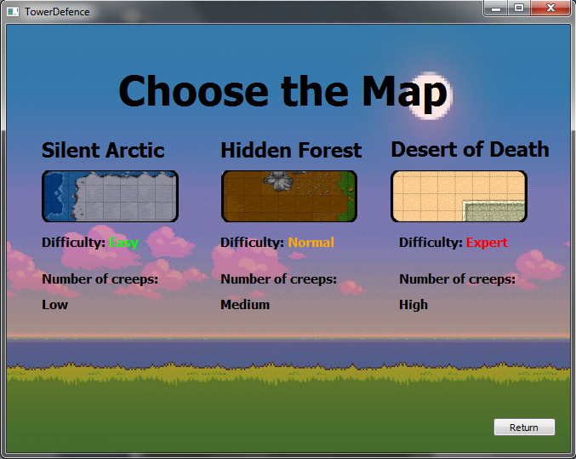
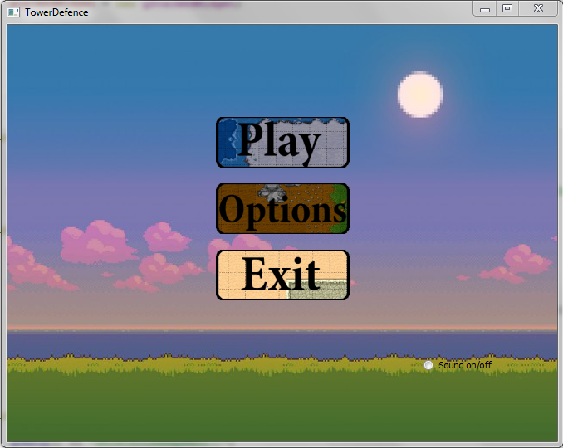
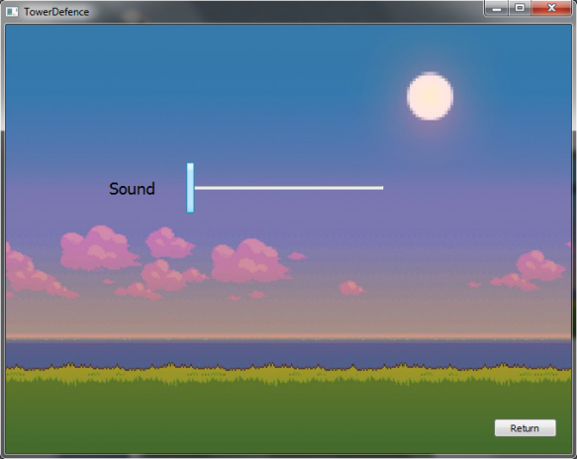
User Interface

Slide 4
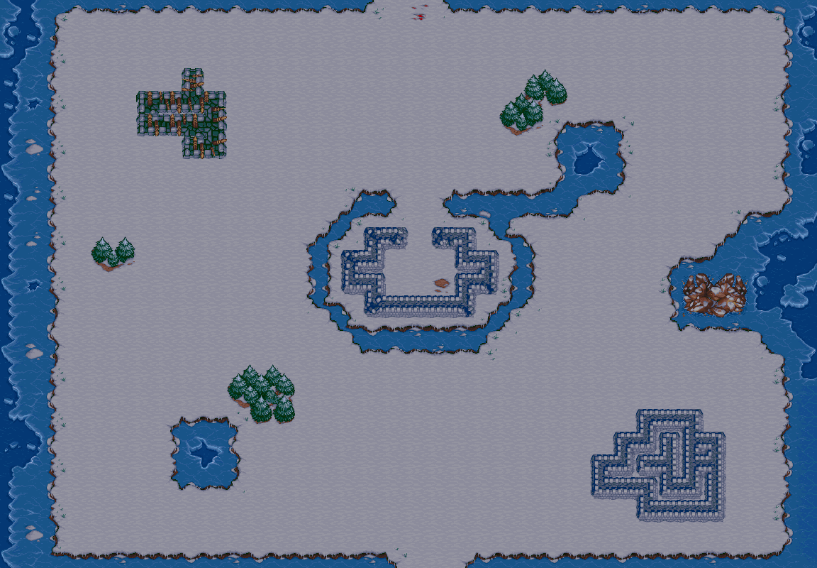
First level Arctic
Spawn Point
Exit Point

Slide 5
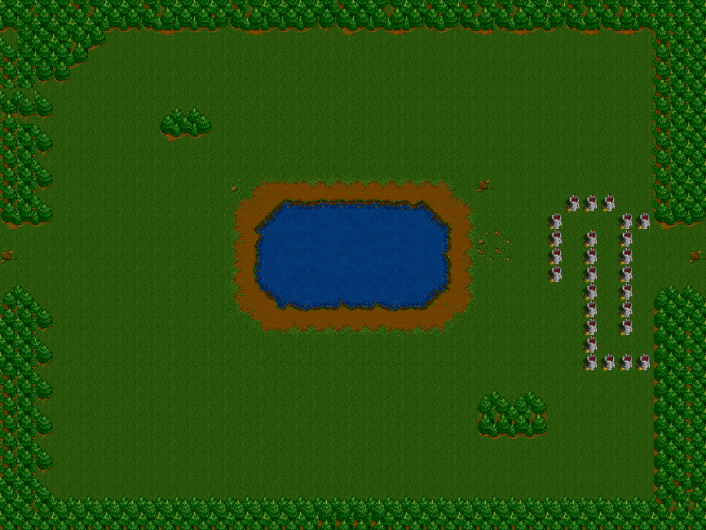
Forest
Tower

Slide 6
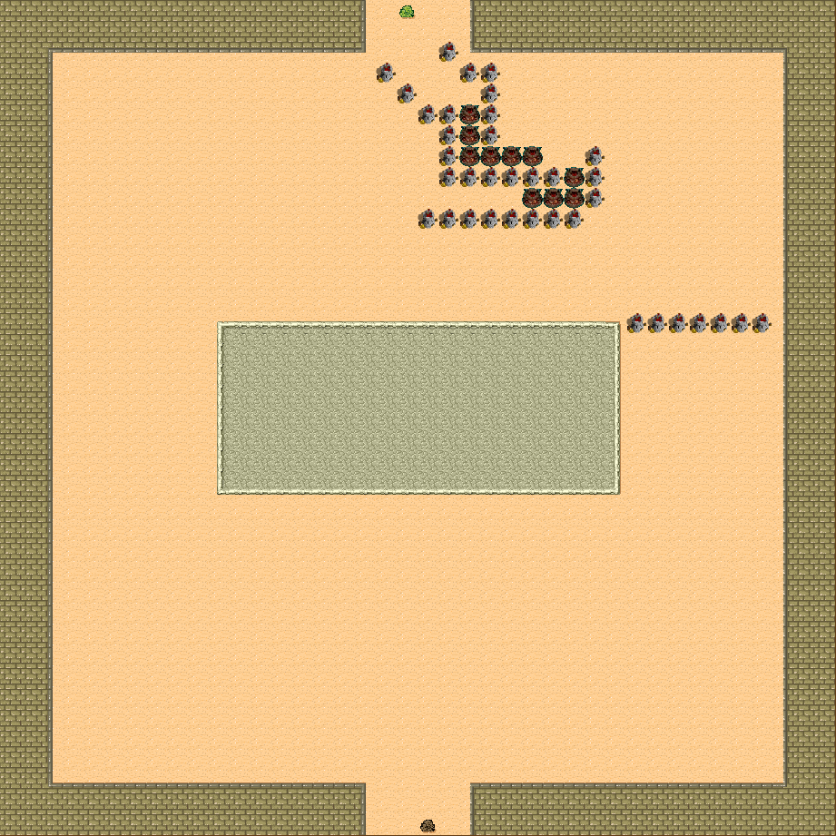
Desert
Creep
Tower

Slide 7
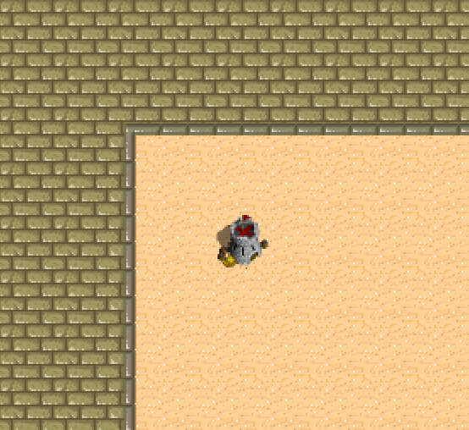
Tower
One aim per shot
Tower’s range

Slide 8
Creep
Use The Wave Algorithm to find the shortest way to exit point
Have 2 parameters: health points and type
If the tower blocks the last way to exit point, destroys this tower

Slide 9
Thanks for listening

